Slide 1
Forcasting Tides
Danny Freeman

Slide 2
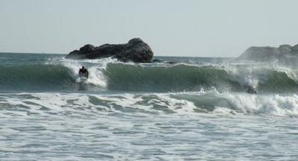
Newport RI

Slide 3
Data Source
NOAA
Scientific Agency with the US Department of Commerce that Focuses on the conditions of the oceans, major water ways and the atmosphere

Slide 4
Why
Concerned about area surrounding
Errosion if tides are increasing??
If they are decreasing??

Slide 5
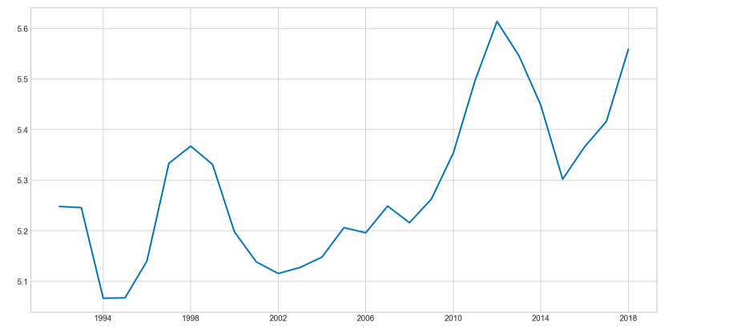
Mean Highest Tide per Month

Slide 6
Modeling
ARMA
SARIMAX

Slide 7
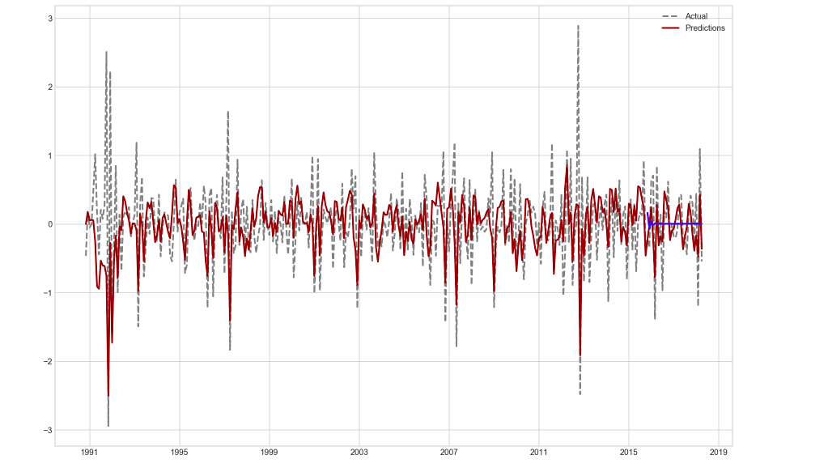
ARMA

Slide 8
Conclusion
Tides are slowly rising

Slide 9
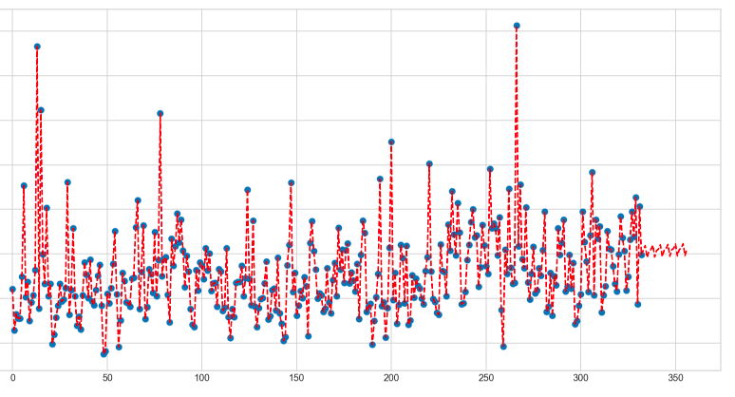
SARIMAX

